Slide 1
Heart Disease Project Analysis Presentation
Presented by Donthi Venkata Aravind

Slide 2
Project analysis slide 5
Project Analysis
ABSTRACT
The main objective of this paper is to predict whether particular person is safe or not.
This document is divided into four sections
(i) Data Collection
(ii) Comparison of data models on collected data (iii) Training of system on most promising model
(iv) Testing
Keywords – Heart disease, KNN, Training, Testing, Prediction.
The performance of the process will be further enhanced with a feature selection implementation, and the results significant improvement will be verified with prediction accuracy.

Slide 3
Project analysis slide 2
Project Analysis
IMPLEMENT
Conclusion
PROJECT
ANALYSIS
DESIGN
TRAINING
TESTING

Slide 4
Project analysis slide 4
Project Analysis
Flow Chart Representation
Heart Disease Prediction
Importing Libraries
To Analyze the data
Dataset
Project Objectives
One of the technique to analyze and predict data
Project Objectives
Implementation of a Project
Using Decision tree Classifier
By using highly advanced libraries in Python
To predict whether the person will suffer from heart disease
Python Script
Using KNN
Best technique to predict the data
Software used

Slide 5
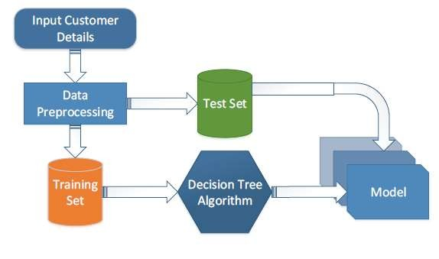
Project Analysis
ARCHITECTURE

Slide 6
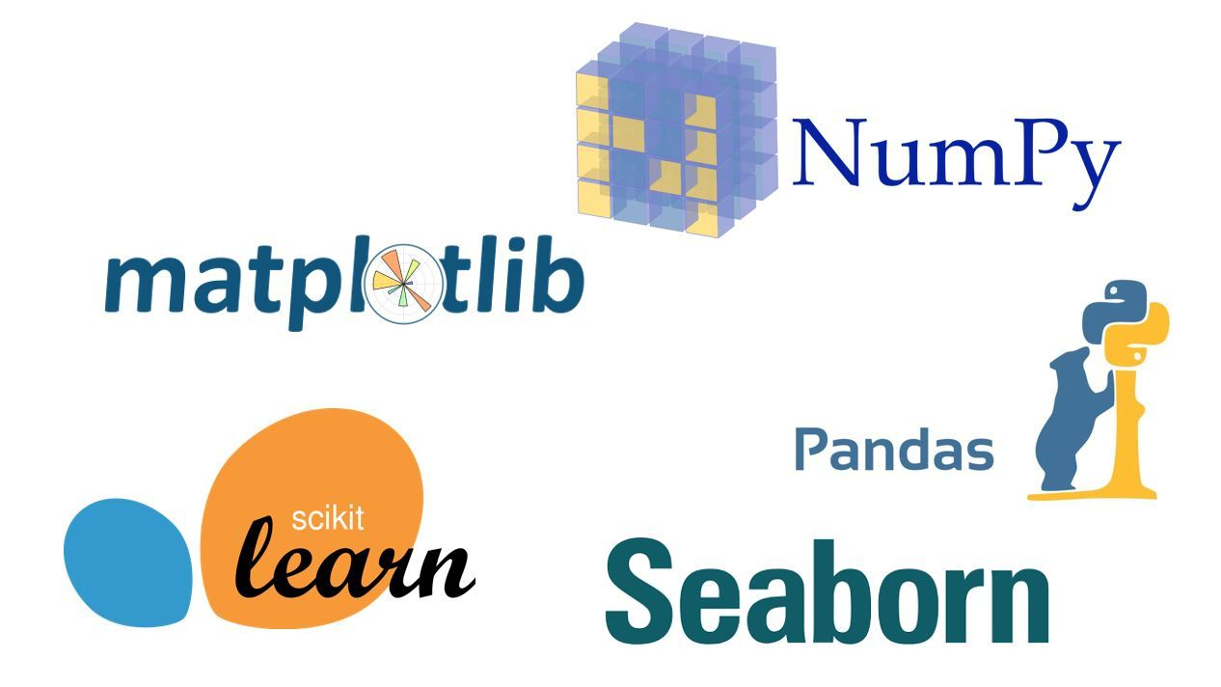
Project Analysis
LIBRARIES

Slide 7
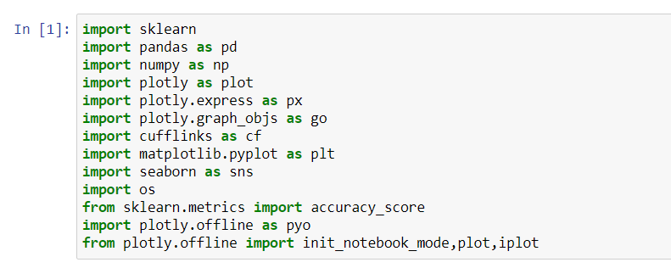
Project analysis slide 8
Project Analysis
Libraries needed for Analysis
Importing Libraries

Slide 8
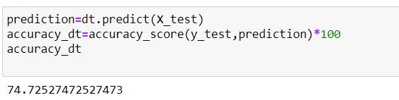
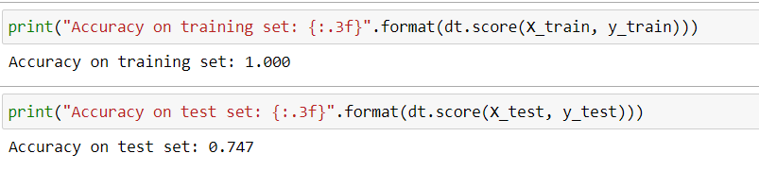
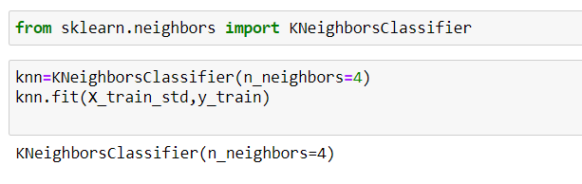
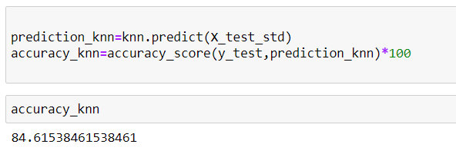
Project analysis slide 10
Project Analysis
Accuracy using Decision Tree Classifier.
Accuracy using KNN
Accuracy using KNN is High when compared to Decision Tree Classifier.

Slide 9
Project analysis slide 7
Project Analysis
Advantage using KNN
Advantage using Decision Tree Classifier
Very simple implementation.
Robust with regard to the search space; for instance, classes don't have to be linearly separable.
Classifier can be updated online at very little cost as new instances with known classes are presented
A significant advantage of a decision tree is that it forces the consideration of all possible outcomes of a decision and traces each path to a conclusion.
It creates a comprehensive analysis of the consequences along each branch and identifies decision nodes that need further analysis.

Slide 10
Thank You

